Slide 1
Qualitative Data Analysis
Carman Neustaedter

Slide 2
Outline
Qualitative research
Analysis methods
Validity and generalizability

Slide 3
Qualitative Research Methods
Interviews
  Ethnographic interviews (Spradley, 1979)
  Contextual interviews (Holtzblatt and Jones, 1995)
Ethnographic observation (Spradley, 1980)
Participatory design sessions (Sanders, 2005)
Field deployments

Slide 4
Qualitative Research Goals
Meaning: how people see the world
Context: the world in which people act
Process: what actions and activities people do
Reasoning: why people act and behave the way they do
Maxwell, 2005
Notes:
The goals of qualitative research are to understand:
Meaning
Context
Process
Reasoning

Slide 5
Quantitative vs. Qualitative
Explanation through numbers
Objective
Deductive reasoning
Predefined variables and measurement
Data collection before analysis
Cause and effect relationships
Explanation through words
Subjective
Inductive reasoning
Creativity, extraneous variables
Data collection and analysis intertwined
Description, meaning
Ron Wardell, EVDS 617 course notes
Notes:
These points are under contention by researchers.
Quantitative research involves explaining a phenomenon based on numerical evidence.
For example, X is faster than Y so X must be better.
Qualitative research involves explaining a phenomenon through words.
For example, using a description of a real world act or process.
Quantitative is objective: it is undistorted by emotion or personal bias; based on observable phenomenon.
Qualitative is subjective: it is influenced by personal opinion, the creativity of the researcher to ask the right questions and see the right actions.
You need to understand what your biases are ahead of time and understand how they will affect the results.
Quantitative relies on deductive reasoning where you will start with a hypothesis or principle and attempt to prove/disprove it.
Qualitative relies on inductive reasoning in which general principles are derived from particular facts or instances. You don’t start with a hypothesis. You start by observing small samples and drawing larger conclusions about populations as a whole from these observations.
Quantitative relies on collecting data first then analysis it to get objective results.
Qualitative relies on collecting data, analyzing it, refining the research method and questions, and then repeating the process.
Quantitative gives you cause and effect relationships.
Qualitative gives you meanings and descriptions of phenomena.

Slide 6
Quantitative vs. Qualitative
Explanation through numbers
Objective
Deductive reasoning
Predefined variables and measurement
Data collection before analysis
Cause and effect relationships
Explanation through words
Subjective
Inductive reasoning
Creativity, extraneous variables
Data collection and analysis intertwined
Description, meaning
Ron Wardell, EVDS 617 course notes
Notes:
These points are under contention by researchers.
Quantitative research involves explaining a phenomenon based on numerical evidence.
For example, X is faster than Y so X must be better.
Qualitative research involves explaining a phenomenon through words.
For example, using a description of a real world act or process.
Quantitative is objective: it is undistorted by emotion or personal bias; based on observable phenomenon.
Qualitative is subjective: it is influenced by personal opinion, the creativity of the researcher to ask the right questions and see the right actions.
You need to understand what your biases are ahead of time and understand how they will affect the results.
Quantitative relies on deductive reasoning where you will start with a hypothesis or principle and attempt to prove/disprove it.
Qualitative relies on inductive reasoning in which general principles are derived from particular facts or instances. You don’t start with a hypothesis. You start by observing small samples and drawing larger conclusions about populations as a whole from these observations.
Quantitative relies on collecting data first then analysis it to get objective results.
Qualitative relies on collecting data, analyzing it, refining the research method and questions, and then repeating the process.
Quantitative gives you cause and effect relationships.
Qualitative gives you meanings and descriptions of phenomena.

Slide 7
Quantitative vs. Qualitative
Explanation through numbers
Objective
Deductive reasoning
Predefined variables and measurement
Data collection before analysis
Cause and effect relationships
Explanation through words
Subjective
Inductive reasoning
Creativity, extraneous variables
Data collection and analysis intertwined
Description, meaning
Ron Wardell, EVDS 617 course notes
Notes:
These points are under contention by researchers.
Quantitative research involves explaining a phenomenon based on numerical evidence.
For example, X is faster than Y so X must be better.
Qualitative research involves explaining a phenomenon through words.
For example, using a description of a real world act or process.
Quantitative is objective: it is undistorted by emotion or personal bias; based on observable phenomenon.
Qualitative is subjective: it is influenced by personal opinion, the creativity of the researcher to ask the right questions and see the right actions.
You need to understand what your biases are ahead of time and understand how they will affect the results.
Quantitative relies on deductive reasoning where you will start with a hypothesis or principle and attempt to prove/disprove it.
Qualitative relies on inductive reasoning in which general principles are derived from particular facts or instances. You don’t start with a hypothesis. You start by observing small samples and drawing larger conclusions about populations as a whole from these observations.
Quantitative relies on collecting data first then analysis it to get objective results.
Qualitative relies on collecting data, analyzing it, refining the research method and questions, and then repeating the process.
Quantitative gives you cause and effect relationships.
Qualitative gives you meanings and descriptions of phenomena.

Slide 8
Quantitative vs. Qualitative
Explanation through numbers
Objective
Deductive reasoning
Predefined variables and measurement
Data collection before analysis
Cause and effect relationships
Explanation through words
Subjective
Inductive reasoning
Creativity, extraneous variables
Data collection and analysis intertwined
Description, meaning
Ron Wardell, EVDS 617 course notes
Notes:
These points are under contention by researchers.
Quantitative research involves explaining a phenomenon based on numerical evidence.
For example, X is faster than Y so X must be better.
Qualitative research involves explaining a phenomenon through words.
For example, using a description of a real world act or process.
Quantitative is objective: it is undistorted by emotion or personal bias; based on observable phenomenon.
Qualitative is subjective: it is influenced by personal opinion, the creativity of the researcher to ask the right questions and see the right actions.
You need to understand what your biases are ahead of time and understand how they will affect the results.
Quantitative relies on deductive reasoning where you will start with a hypothesis or principle and attempt to prove/disprove it.
Qualitative relies on inductive reasoning in which general principles are derived from particular facts or instances. You don’t start with a hypothesis. You start by observing small samples and drawing larger conclusions about populations as a whole from these observations.
Quantitative relies on collecting data first then analysis it to get objective results.
Qualitative relies on collecting data, analyzing it, refining the research method and questions, and then repeating the process.
Quantitative gives you cause and effect relationships.
Qualitative gives you meanings and descriptions of phenomena.

Slide 9
Quantitative vs. Qualitative
Explanation through numbers
Objective
Deductive reasoning
Predefined variables and measurement
Data collection before analysis
Cause and effect relationships
Explanation through words
Subjective
Inductive reasoning
Creativity, extraneous variables
Data collection and analysis intertwined
Description, meaning
Ron Wardell, EVDS 617 course notes
Notes:
These points are under contention by researchers.
Quantitative research involves explaining a phenomenon based on numerical evidence.
For example, X is faster than Y so X must be better.
Qualitative research involves explaining a phenomenon through words.
For example, using a description of a real world act or process.
Quantitative is objective: it is undistorted by emotion or personal bias; based on observable phenomenon.
Qualitative is subjective: it is influenced by personal opinion, the creativity of the researcher to ask the right questions and see the right actions.
You need to understand what your biases are ahead of time and understand how they will affect the results.
Quantitative relies on deductive reasoning where you will start with a hypothesis or principle and attempt to prove/disprove it.
Qualitative relies on inductive reasoning in which general principles are derived from particular facts or instances. You don’t start with a hypothesis. You start by observing small samples and drawing larger conclusions about populations as a whole from these observations.
Quantitative relies on collecting data first then analysis it to get objective results.
Qualitative relies on collecting data, analyzing it, refining the research method and questions, and then repeating the process.
Quantitative gives you cause and effect relationships.
Qualitative gives you meanings and descriptions of phenomena.

Slide 10
Quantitative vs. Qualitative
Explanation through numbers
Objective
Deductive reasoning
Predefined variables and measurement
Data collection before analysis
Cause and effect relationships
Explanation through words
Subjective
Inductive reasoning
Creativity, extraneous variables
Data collection and analysis intertwined
Description, meaning
Ron Wardell, EVDS 617 course notes
Notes:
These points are under contention by researchers.
Quantitative research involves explaining a phenomenon based on numerical evidence.
For example, X is faster than Y so X must be better.
Qualitative research involves explaining a phenomenon through words.
For example, using a description of a real world act or process.
Quantitative is objective: it is undistorted by emotion or personal bias; based on observable phenomenon.
Qualitative is subjective: it is influenced by personal opinion, the creativity of the researcher to ask the right questions and see the right actions.
You need to understand what your biases are ahead of time and understand how they will affect the results.
Quantitative relies on deductive reasoning where you will start with a hypothesis or principle and attempt to prove/disprove it.
Qualitative relies on inductive reasoning in which general principles are derived from particular facts or instances. You don’t start with a hypothesis. You start by observing small samples and drawing larger conclusions about populations as a whole from these observations.
Quantitative relies on collecting data first then analysis it to get objective results.
Qualitative relies on collecting data, analyzing it, refining the research method and questions, and then repeating the process.
Quantitative gives you cause and effect relationships.
Qualitative gives you meanings and descriptions of phenomena.

Slide 11
Quantitative vs. Qualitative
Explanation through numbers
Objective
Deductive reasoning
Predefined variables and measurement
Data collection before analysis
Cause and effect relationships
Explanation through words
Subjective
Inductive reasoning
Creativity, extraneous variables
Data collection and analysis intertwined
Description, meaning
Ron Wardell, EVDS 617 course notes
Notes:
These points are under contention by researchers.
Quantitative research involves explaining a phenomenon based on numerical evidence.
For example, X is faster than Y so X must be better.
Qualitative research involves explaining a phenomenon through words.
For example, using a description of a real world act or process.
Quantitative is objective: it is undistorted by emotion or personal bias; based on observable phenomenon.
Qualitative is subjective: it is influenced by personal opinion, the creativity of the researcher to ask the right questions and see the right actions.
You need to understand what your biases are ahead of time and understand how they will affect the results.
Quantitative relies on deductive reasoning where you will start with a hypothesis or principle and attempt to prove/disprove it.
Qualitative relies on inductive reasoning in which general principles are derived from particular facts or instances. You don’t start with a hypothesis. You start by observing small samples and drawing larger conclusions about populations as a whole from these observations.
Quantitative relies on collecting data first then analysis it to get objective results.
Qualitative relies on collecting data, analyzing it, refining the research method and questions, and then repeating the process.
Quantitative gives you cause and effect relationships.
Qualitative gives you meanings and descriptions of phenomena.

Slide 12
Getting ‘Good’ Qualitative Results
Depends on:
  The quality of the data collector
  The quality of the data analyzer
  The quality of the presenter / writer
Ron Wardell, EVDS 617 course notes
Notes:
Quality of the data collector: listening skills, interpersonal skills, observational skills
Quality of the data analyzer: interpretation, inference
Quality of the presenter / writer: if the person is able to effectively communicate the phenomenon

Slide 13
Qualitative Data
Written field notes
Audio recordings of conversations
Video recordings of activities
Diary recordings of activities / thoughts

Slide 14
Qualitative Data
Depth information on:
  thoughts, views, interpretations
  priorities, importance
  processes, practices
  intended effects of actions
  feelings and experiences
Ron Wardell, EVDS 617 course notes

Slide 15
Outline
Qualitative research
Analysis methods
Validity and generalizability

Slide 16
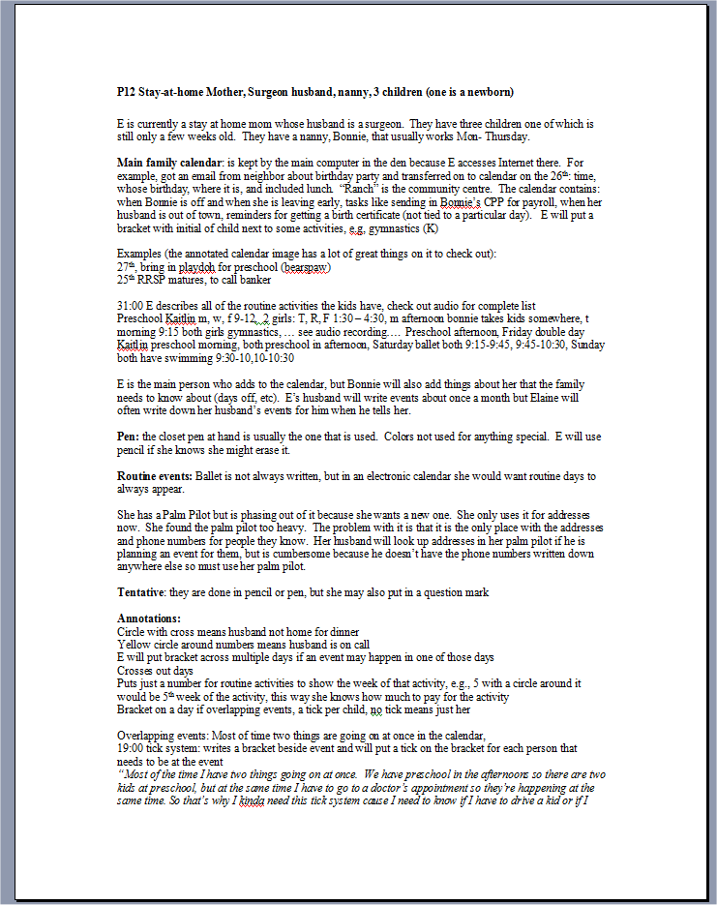
Data Analysis
Open Coding
Systematic Coding
Affinity Diagramming

Slide 17
Open Coding
Treat data as answers to open-ended questions
  ask data specific questions
  assign codes for answers
  record theoretical notes
Strauss and Corbin, 1998, Ron Wardell, EVDS 617 course notes

Slide 18
Example: Calendar Routines
Families were interviewed about their calendar routines
  What calendars they had
  Where they kept their calendars
  What types of events they recorded
  …
Written notes
Audio recordings
Neustaedter, 2007

Slide 19
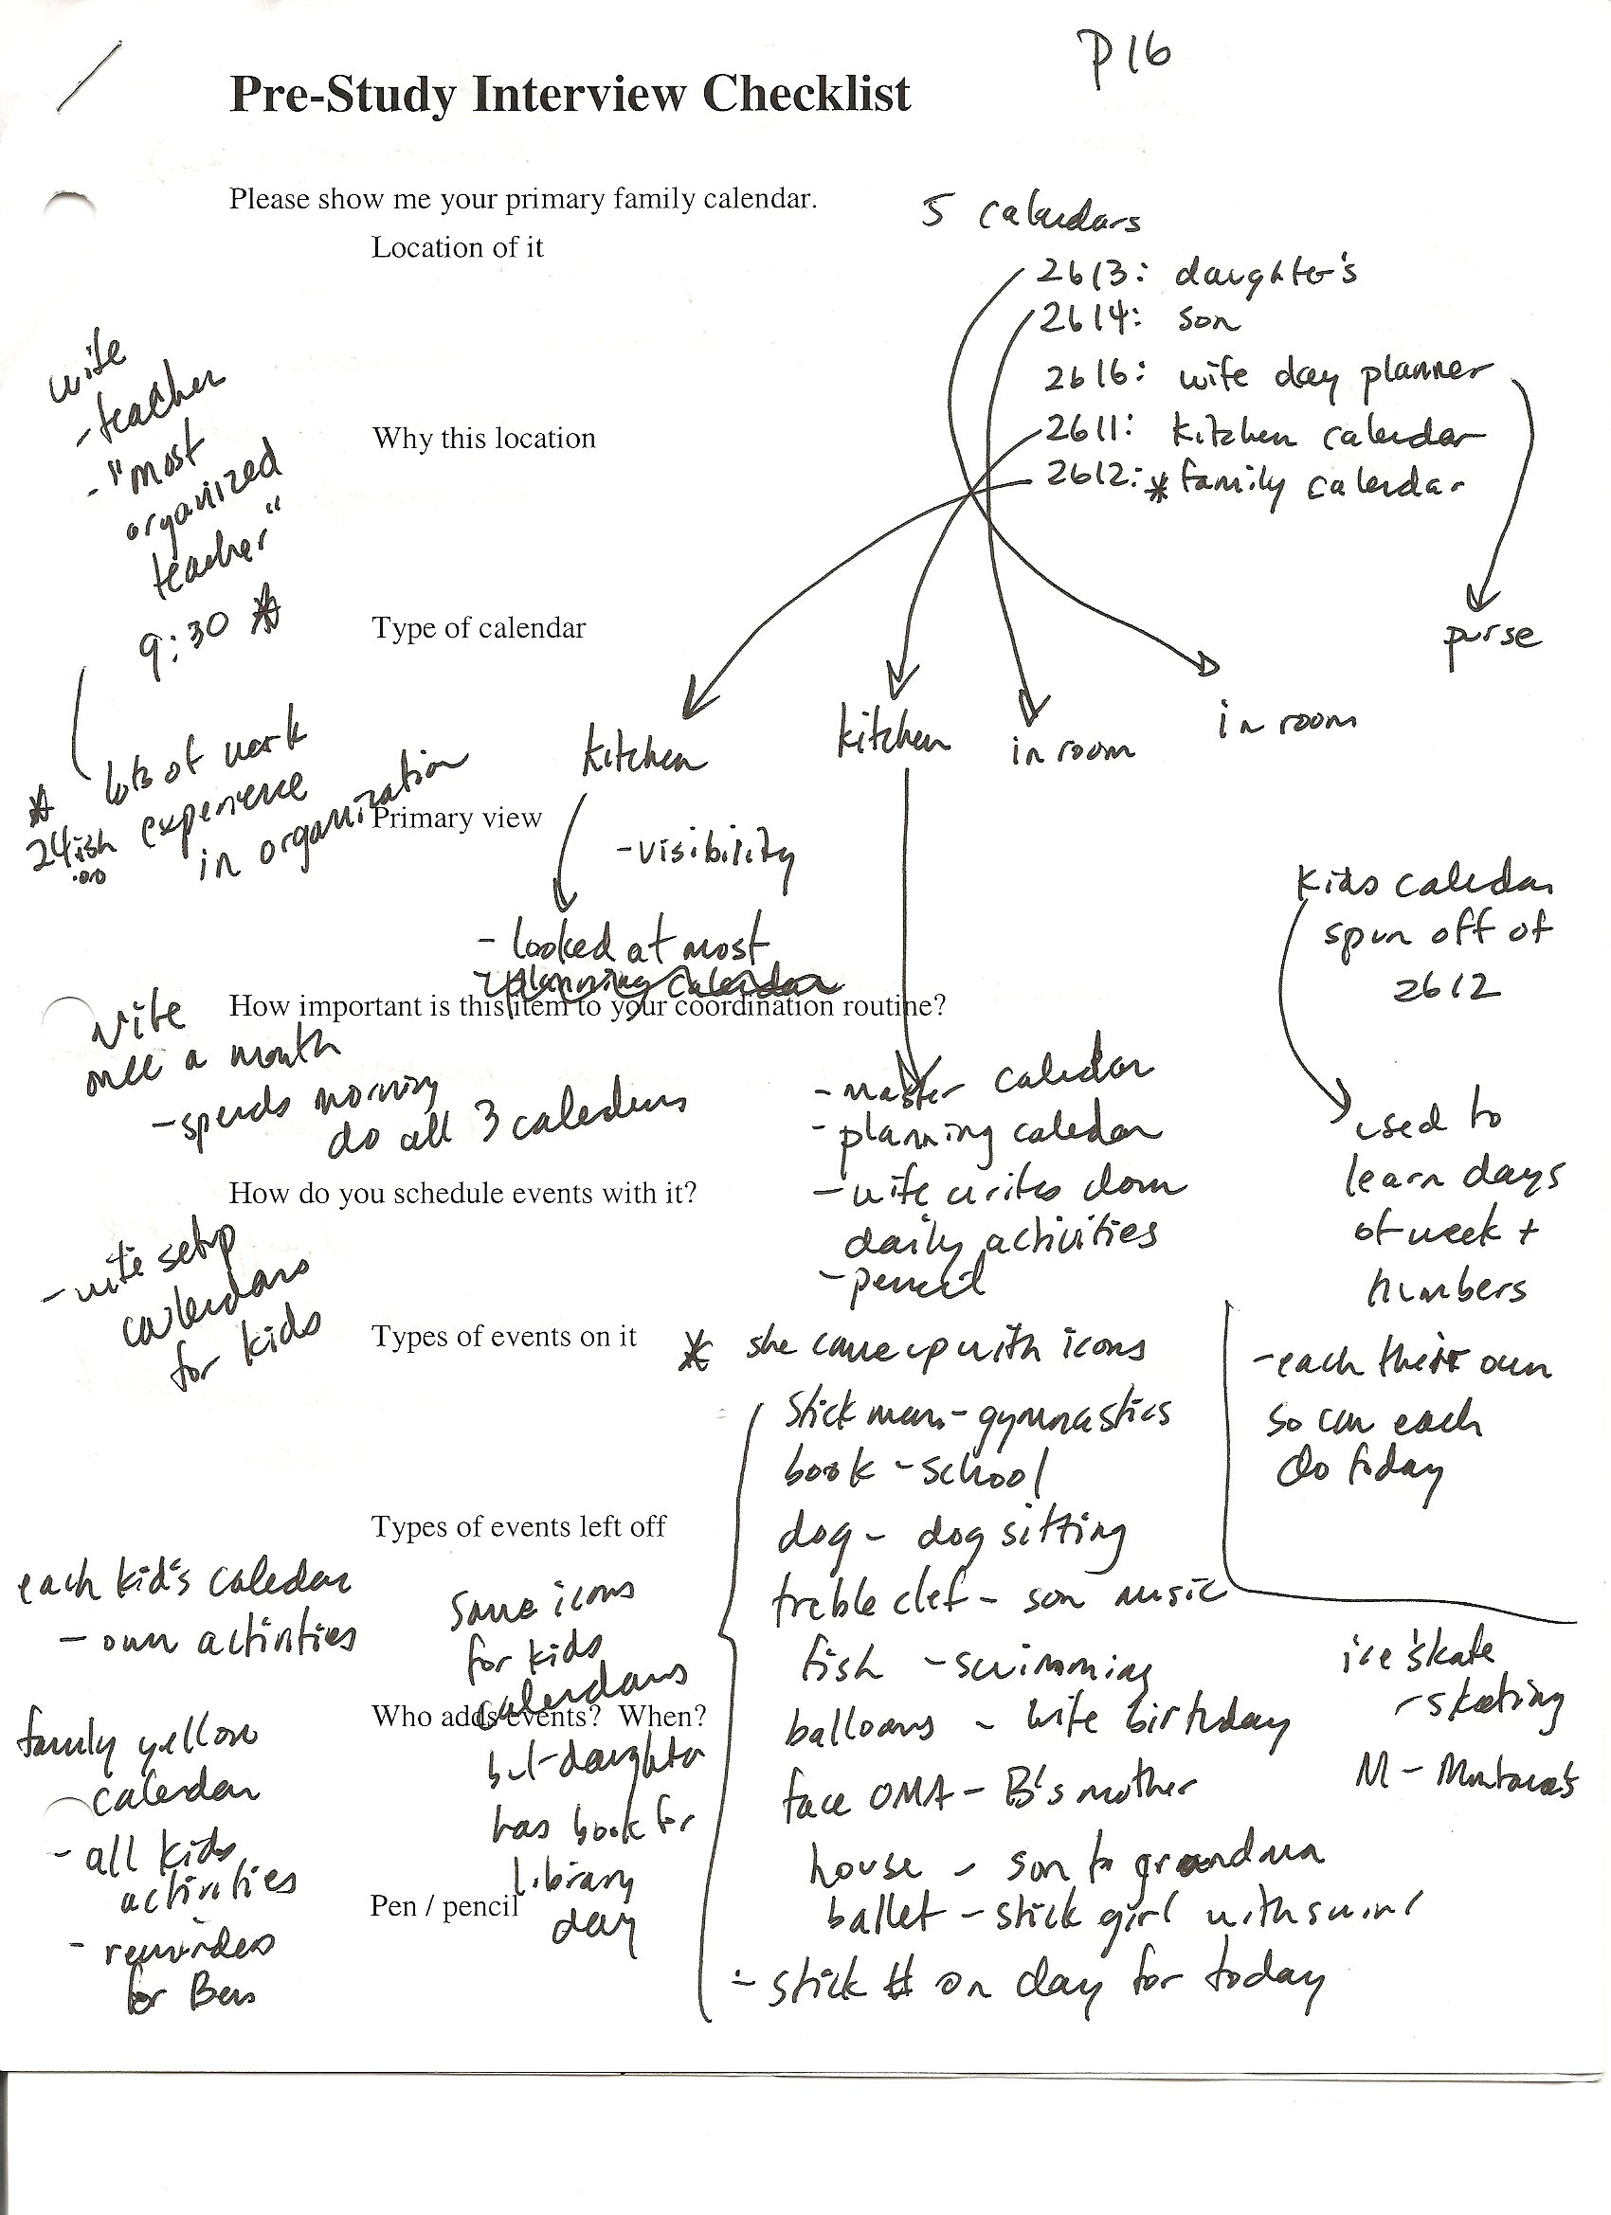
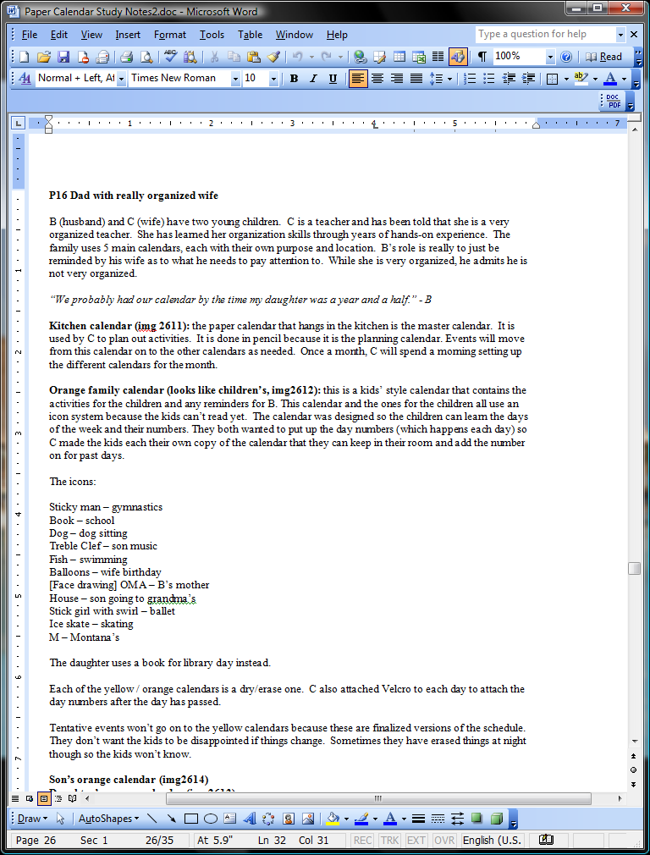
Example: Calendar Routines
Step 1: translate field notes (optional)
paper
digital

Slide 20
Example: Calendar Routines
Step 2: list questions / focal points
Where do families keep their calendars?
What uses do they have for their calendars?
Who adds to the calendars?
When do people check the calendars?
…
(you may end up adding to this list as you go through your data)

Slide 21
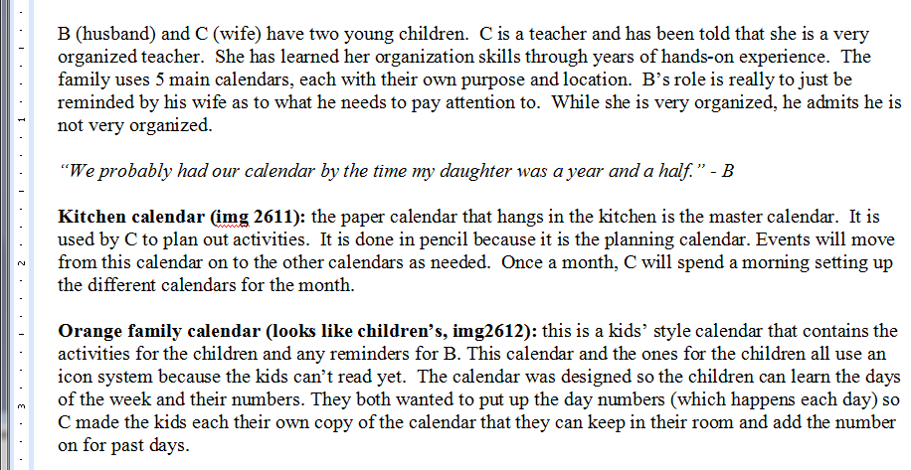
Example: Calendar Routines
Step 3: go through data and ask questions
Where do families keep their calendars?

Slide 22
Example: Calendar Routines
Step 3: go through data and ask questions
Calendar Locations:
[KI] – the kitchen
[KI]
[KI]
[KI]
Where do families keep their calendars?

Slide 23
Example: Calendar Routines
Step 3: go through data and ask questions
Calendar Locations:
[KI] – the kitchen
[CR] – child’s room
[KI]
[CR]
Where do families keep their calendars?

Slide 24
Example: Calendar Routines
Step 3: go through data and ask questions
Calendar Locations:
[KI] – the kitchen
[CR] – child’s room
[KI]
[CR]
Continue for the remaining questions….

Slide 25
Example: Calendar Routines
The result:
  list of codes
  frequency of each code
  a sense of the importance of each code
  frequency != importance

Slide 26
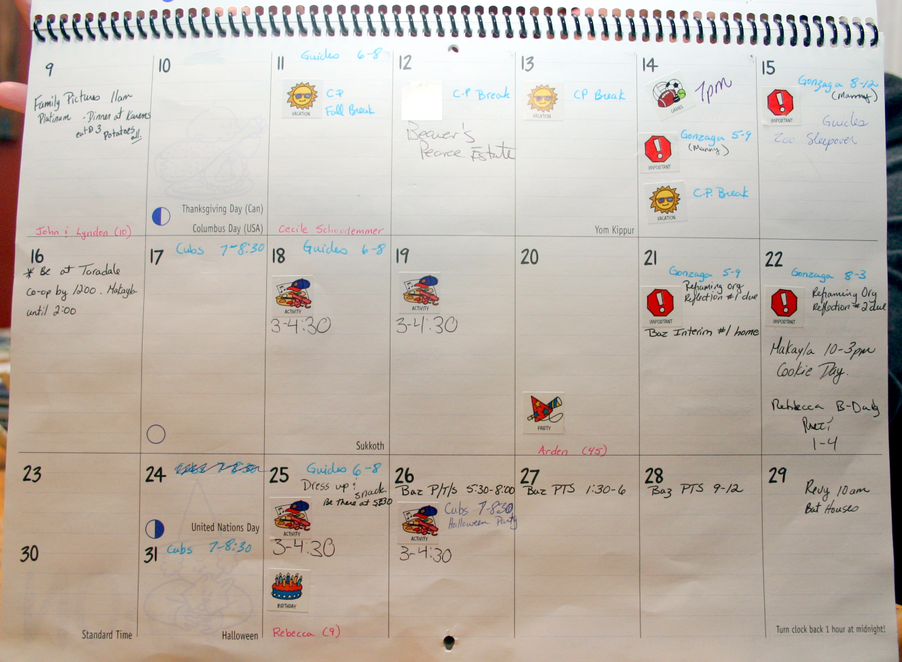
Example 2: Calendar Contents
Pictures were taken of family calendars
Neustaedter, 2007

Slide 27
Example: Calendar Contents
Step 1: list questions / focal points
What type of events are on the calendar?
Who are the events for?
What other markings are made on the calendar?
…
(you may end up adding to this list as you go through your data)

Slide 28
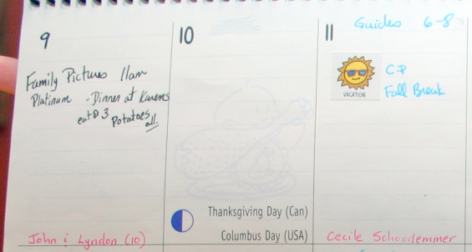
Example: Calendar Contents
Step 2: go through data and ask questions
What types of events are on the calendar?

Slide 29
Example: Calendar Contents
Step 2: go through data and ask questions
[FO]
Types of Events:
[FO] – family outing
What types of events are on the calendar?

Slide 30
Example: Calendar Contents
Step 2: go through data and ask questions
[FO]
Types of Events:
[FO] – family outing
[AN] - anniversary
[AN]
What types of events are on the calendar?

Slide 31
Example: Calendar Contents
Step 2: go through data and ask questions
[FO]
Types of Events:
[FO] – family outing
[AN] - anniversary
[AN]
Continue for the remaining questions….

Slide 32

Reporting Results
Find the main themes
Use quotes / scenarios to represent them
Include counts for codes (optional)

Slide 33
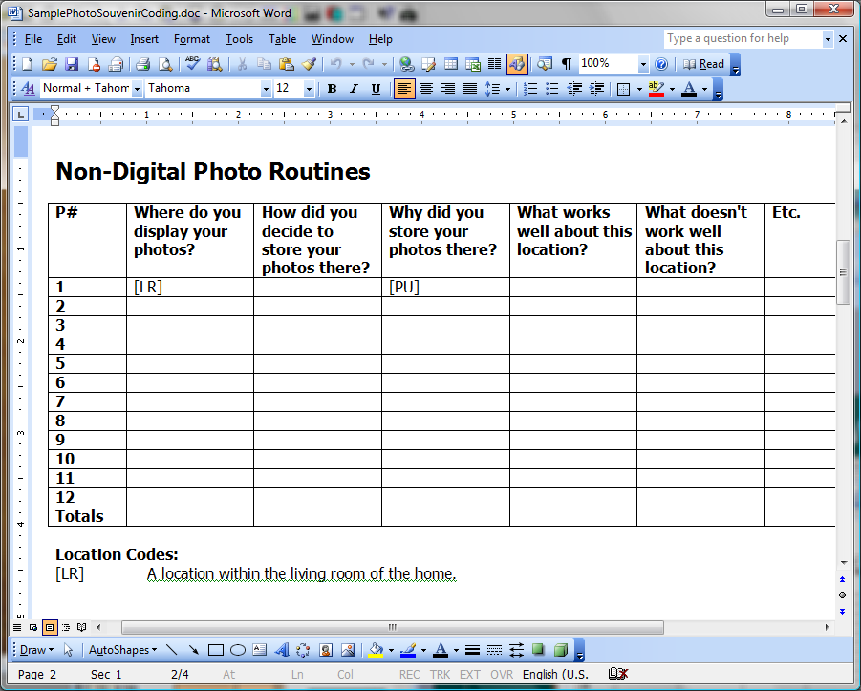
Software: Microsoft Word

Slide 34
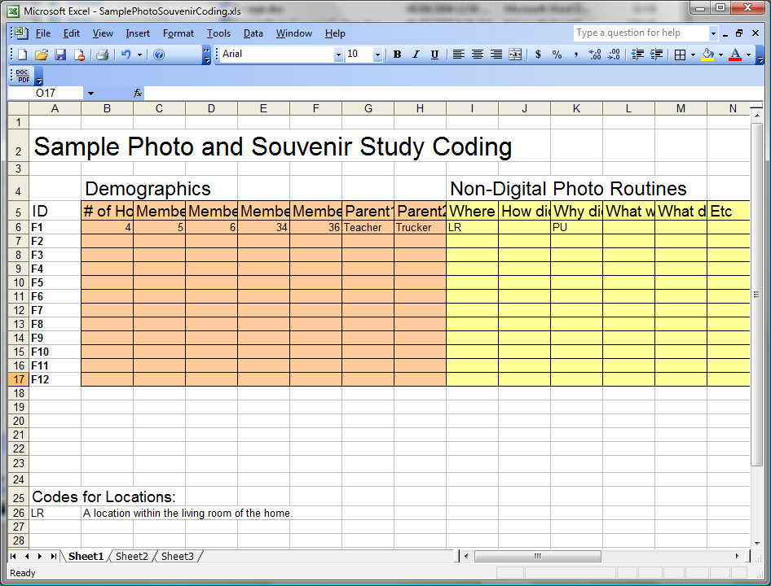
Software: Microsoft Excel

Slide 35
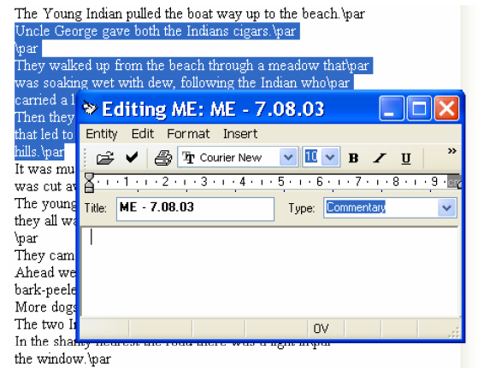
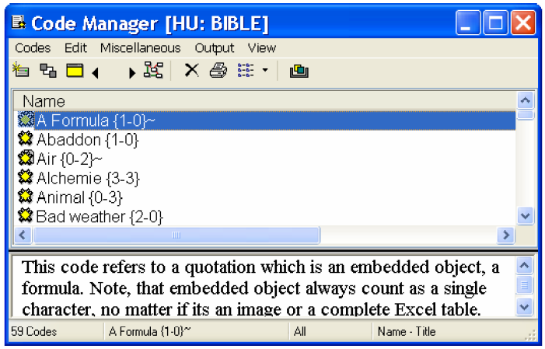
Software: ATLAS.ti
http://www.atlasti.com/ -- free trial available

Slide 36
Data Analysis
Open Coding
Systematic Coding
Affinity Diagramming

Slide 37
Systematic Coding
Categories are created ahead of time
  from existing literature
  from previous open coding
Code the data just like open coding
Ron Wardell, EVDS 617 course notes

Slide 38
Data Analysis
Open Coding
Systematic Coding
Affinity Diagramming

Slide 39
Affinity Diagramming
Goal: what are the main themes?
  Write ideas on sticky notes
  Place notes on a large wall / surface
  Group notes hierarchically to see main themes
Holtzblatt et al., 2005

Slide 40
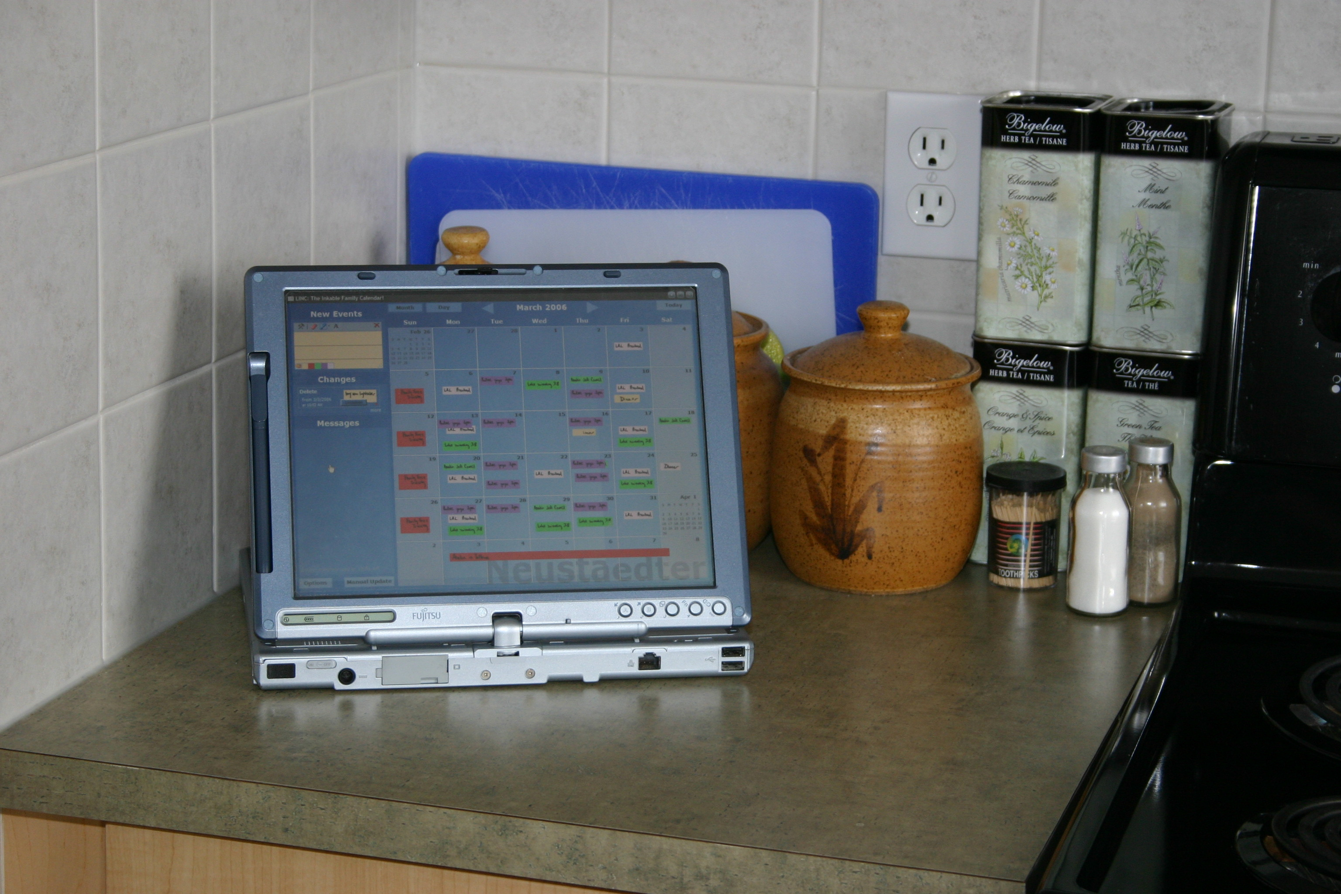
Example: Calendar Field Study
Families were given a digital calendar to use in their homes
Thoughts / reactions recorded:
  Weekly interview notes
  Audio recordings from interviews
Neustaedter, 2007

Slide 41
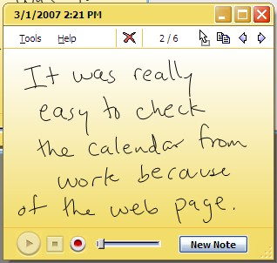
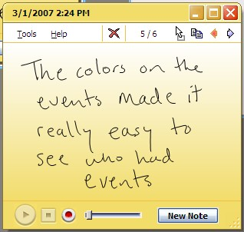
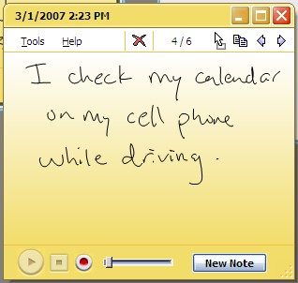
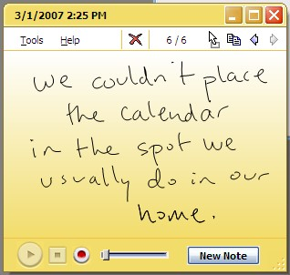
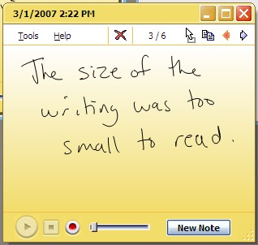
Example: Calendar Field Study
Step 1: Affinity Notes
  go through data and write observations down on post-it notes
  each note contains one idea

Slide 42
Example: Calendar Field Study
Step 2: Diagram Building
  place all notes on a wall / surface

Slide 43
Example: Calendar Field Study
Step 3: Diagram Building
  move notes into related columns / piles

Slide 44
Example: Calendar Field Study
Step 3: Diagram Building
  move notes into related columns / piles

Slide 45
Example: Calendar Field Study
Step 3: Diagram Building
  move notes into related columns / piles

Slide 46
Example: Calendar Field Study
Step 3: Diagram Building
  move notes into related columns / piles

Slide 47
Example: Calendar Field Study
Step 3: Diagram Building
  move notes into related columns / piles

Slide 48
Example: Calendar Field Study
Step 3: Diagram Building
  move notes into related columns / piles

Slide 49
Example: Calendar Field Study
Step 3: Diagram Building
  move notes into related columns / piles

Slide 50
Example: Calendar Field Study
Step 4: Affinity Labels
  write labels describing each group

Slide 51
Example: Calendar Field Study
Step 4: Affinity Labels
  write labels describing each group
Calendar placement is a challenge

Slide 52
Example: Calendar Field Study
Step 4: Affinity Labels
  write labels describing each group
Calendar placement is a challenge
Interface visuals affect usage

Slide 53
Example: Calendar Field Study
Step 4: Affinity Labels
  write labels describing each group
People check the calendar when not at home
Calendar placement is a challenge
Interface visuals affect usage

Slide 54
Example: Calendar Field Study
Step 5: Further Refine Groupings
  see Holtzblatt et al. 2005
People check the calendar when not at home
Calendar placement is a challenge
Interface visuals affect usage

Slide 55
Outline
Qualitative research
Analysis methods
Validity and generalizability

Slide 56
Validity Threats
Bias
  researcher’s influence on the study
  e.g., studying one’s own culture
Reactivity
  researcher's effect on the setting or people
  e.g., people may do things differently
Maxwell, 2005
Notes:
Understand the threats that may exist and try to rule them out or understand how they affect the results.

Slide 57
Validity Tests
Intensive / long term
Rich data
Respondent validation
Intervention
Negative cases
Triangulation
Quasi-statistics
Comparison
Maxwell, 2005
Notes:
There are several ways to ensure your results are valid.
validity tests:
- intensive, long term endearment -- more data, repeated observation and interviews
- rich data -- full and detailed descriptions
- respondent validation -- ask them if the reportings are correct (though this could be
just as invalid as the original work)
- intervention -- interact with them and see how behavior changes
- searching for negative cases
- triangulation -- collect data from a variety of settings and methods
- quasi-statistics -- e.g., frequency counts
- comparison -- multicase, multisite studies

Slide 58
Validity Tests
Intensive / long term
Rich data
Respondent validation
Intervention
Negative cases
Triangulation
Quasi-statistics
Comparison
Maxwell, 2005
Notes:
There are several ways to ensure your results are valid.
validity tests:
- intensive, long term endearment -- more data, repeated observation and interviews
- rich data -- full and detailed descriptions
- respondent validation -- ask them if the reportings are correct (though this could be
just as invalid as the original work)
- intervention -- interact with them and see how behavior changes
- searching for negative cases
- triangulation -- collect data from a variety of settings and methods
- quasi-statistics -- e.g., frequency counts
- comparison -- multicase, multisite studies

Slide 59
Validity Tests
Intensive / long term
Rich data
Respondent validation
Intervention
Negative cases
Triangulation
Quasi-statistics
Comparison
Maxwell, 2005
Notes:
There are several ways to ensure your results are valid.
validity tests:
- intensive, long term endearment -- more data, repeated observation and interviews
- rich data -- full and detailed descriptions
- respondent validation -- ask them if the reportings are correct (though this could be
just as invalid as the original work)
- intervention -- interact with them and see how behavior changes
- searching for negative cases
- triangulation -- collect data from a variety of settings and methods
- quasi-statistics -- e.g., frequency counts
- comparison -- multicase, multisite studies

Slide 60
Validity Tests
Intensive / long term
Rich data
Respondent validation
Intervention
Negative cases
Triangulation
Quasi-statistics
Comparison
Maxwell, 2005
Notes:
There are several ways to ensure your results are valid.
validity tests:
- intensive, long term endearment -- more data, repeated observation and interviews
- rich data -- full and detailed descriptions
- respondent validation -- ask them if the reportings are correct (though this could be
just as invalid as the original work)
- intervention -- interact with them and see how behavior changes
- searching for negative cases
- triangulation -- collect data from a variety of settings and methods
- quasi-statistics -- e.g., frequency counts
- comparison -- multicase, multisite studies

Slide 61
Validity Tests
Intensive / long term
Rich data
Respondent validation
Intervention
Negative cases
Triangulation
Quasi-statistics
Comparison
Maxwell, 2005
Notes:
There are several ways to ensure your results are valid.
validity tests:
- intensive, long term endearment -- more data, repeated observation and interviews
- rich data -- full and detailed descriptions
- respondent validation -- ask them if the reportings are correct (though this could be
just as invalid as the original work)
- intervention -- interact with them and see how behavior changes
- searching for negative cases
- triangulation -- collect data from a variety of settings and methods
- quasi-statistics -- e.g., frequency counts
- comparison -- multicase, multisite studies

Slide 62
Validity Tests
Intensive / long term
Rich data
Respondent validation
Intervention
Negative cases
Triangulation
Quasi-statistics
Comparison
Maxwell, 2005
Notes:
There are several ways to ensure your results are valid.
validity tests:
- intensive, long term endearment -- more data, repeated observation and interviews
- rich data -- full and detailed descriptions
- respondent validation -- ask them if the reportings are correct (though this could be
just as invalid as the original work)
- intervention -- interact with them and see how behavior changes
- searching for negative cases
- triangulation -- collect data from a variety of settings and methods
- quasi-statistics -- e.g., frequency counts
- comparison -- multicase, multisite studies

Slide 63
Validity Tests
Intensive / long term
Rich data
Respondent validation
Intervention
Negative cases
Triangulation
Quasi-statistics
Comparison
Maxwell, 2005
Notes:
There are several ways to ensure your results are valid.
validity tests:
- intensive, long term endearment -- more data, repeated observation and interviews
- rich data -- full and detailed descriptions
- respondent validation -- ask them if the reportings are correct (though this could be
just as invalid as the original work)
- intervention -- interact with them and see how behavior changes
- searching for negative cases
- triangulation -- collect data from a variety of settings and methods
- quasi-statistics -- e.g., frequency counts
- comparison -- multicase, multisite studies

Slide 64
Validity Tests
Intensive / long term
Rich data
Respondent validation
Intervention
Negative cases
Triangulation
Quasi-statistics
Comparison
Maxwell, 2005
Notes:
There are several ways to ensure your results are valid.
validity tests:
- intensive, long term endearment -- more data, repeated observation and interviews
- rich data -- full and detailed descriptions
- respondent validation -- ask them if the reportings are correct (though this could be
just as invalid as the original work)
- intervention -- interact with them and see how behavior changes
- searching for negative cases
- triangulation -- collect data from a variety of settings and methods
- quasi-statistics -- e.g., frequency counts
- comparison -- multicase, multisite studies

Slide 65
Validity Tests
Intensive / long term
Rich data
Respondent validation
Intervention
Negative cases
Triangulation
Quasi-statistics
Comparison
Maxwell, 2005
Notes:
There are several ways to ensure your results are valid.
validity tests:
- intensive, long term endearment -- more data, repeated observation and interviews
- rich data -- full and detailed descriptions
- respondent validation -- ask them if the reportings are correct (though this could be
just as invalid as the original work)
- intervention -- interact with them and see how behavior changes
- searching for negative cases
- triangulation -- collect data from a variety of settings and methods
- quasi-statistics -- e.g., frequency counts
- comparison -- multicase, multisite studies

Slide 66
Generalizability
Internal generalizability
  do findings extend within the group studied?
External generalizability
  do findings extend outside the group studied?
Face generalizability
  there is no reason to believe the results don’t generalize
Maxwell, 2005
Notes:
Internal generalizability: you may have studied only a few people within a larger group. Do findings extend to all people in this group?
External generalizability: do findings extend outside this group?
This is typically not the focus as qualitative studies focus on one particular type of group.
It is difficult to get external validity (generalizability) with qualitative research. Instead, you should seek face generalizability -- there is no obvious reason not to believe that the results don't genearlize to the larger population. Use some of the validity tests just described to do this, look for negative cases, etc.

Slide 67
Summary
Qualitative goals:
  meaning, context, process, reasoning
Good qualitative research:
  data collector / analyzer / presenter

Slide 68
Summary
Qualitative data:
  detailed descriptions (audio, written, video)
Analysis methods:
  open coding
  systematic coding
  affinity diagramming

Slide 69
Summary
Report descriptions / scenarios / quotes
Look for face generalizability
Use validity tests

Slide 70
References
Dix, A., Finlay, J., Abowd, G., & Beale, R., (1998) Human Computer Interaction, 2nd ed. Toronto: Prentice-Hall.
  - Chapter 11: qualitative methods in general
Holtzblatt, K, and Jones, S., (1995) Conducting and Analyzing a Contextual Interview, In Readings in Human-Computer Interaction: Toward the Year 2000, 2nd ed., R.M. Baecker,et al., Editors, Morgan Kaufman, pp. 241-253.
  - conducting and analyzing contextual interviews
Holtzblatt, K, Wendell, J., and Wood, S., (2005) Rapid Contextual Design: A How-To Guide to Key Techniques for User-Centered Design, Morgan Kaufmann.
  - Chapter 8: building affinity diagrams
Maxwell, J., (2005) Qualitative Research Design, In Applied Social Research Methods Series, Volume 41.
- Chapter 1: a model for qualitative research design
- Chapter 5: choosing qualitative methods and analysis
- Chapter 6: validity and generalizability
Neustaedter, C. 2007. Domestic Awareness and Family Calendars, PhD Dissertation, University of Calgary, Canada.
- example qualitative studies, analysis, and results reporting
Sanders, E.B. 1999. From User-Centered to Participatory Design Approaches, In Design and Social Sciences, J. Frascara (Ed.), Taylor and Francis Books Limited.
- participatory design for idea generation
Spradley, J. (1979) The Ethnographic Interview, Holt, Rinehart & Winston.
- Part 2, Step 2: interviewing an informant
- Part 2, Step 5: analyzing ethnographic interviews
Spradley, J., (1980) Participant Observation, Harcourt Brace Jovanovich.
- Part 2, Step 2: doing participant observation
- Part 2, Step 3: making an ethnographic record
Strauss, A., and Corbin, J., (1998). Basics of Qualitative Research: Techniques and Procedures for Developing Grounded Theory, SAGE Publications.
- Part 2: coding procedures

